Slide 1
Capstone Project - 3
Online Retail Customer Segmentation
ML Unsupervised Clustering
Individual Project:
Soumya Ranjan Mishra

Slide 2
Contents
● Problem Statement
● Data Summary
● Data Analysis
● Analysis Details
● RFM Table for Customer ID
● Data Preparation
● Implementing Various Clustering Algorithms
● RFM Table for Cluster ID
● Challenges
● Conclusions

Slide 3

Problem Statements
Identify major customer segments on UK Based online retail dataset.
Create RFM Table.

Slide 4
Data Summary
InvoiceNo: Invoice number. Nominal, a 6-digit integral number uniquely assigned to each transaction. If this code starts with letter 'c', it indicates a cancellation.
StockCode: Product (item) code. Nominal, a 5-digit integral number uniquely assigned to each distinct product.
Description: Product (item) name. Nominal.
Quantity: The quantities of each product (item) per transaction. Numeric.
InvoiceDate: Invoice Date and time. Numeric, the day and time when each transaction was generated.
UnitPrice: Unit price. Numeric, Product price per unit in sterling.
CustomerID: Customer number. Nominal, a 5-digit integral number uniquely assigned to each customer.
Country: Country name. Nominal, the name of the country where each customer resides.

Slide 5
Basic Data Exploration
● The dataset has 541909 rows and 8 features(columns).
●Four categorical features ‘InvoiceNo’, ‘StockCode’, & ‘Description’, ‘ Country’.
● One Datetime[ns] features ‘InvoiceDate’.
● Outliers present only in “Quantity” & “UnitPrice”column.
● Missing Values on Description & CustomerID columns.
● Duplicated values present.

Slide 6
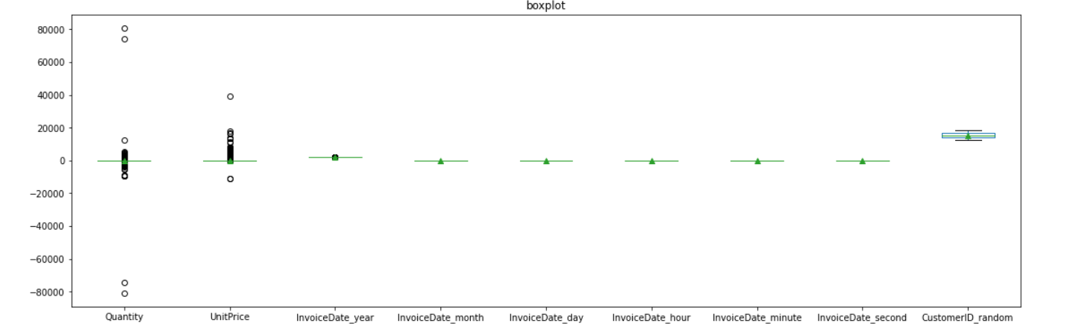
Outliers in the features

Slide 7
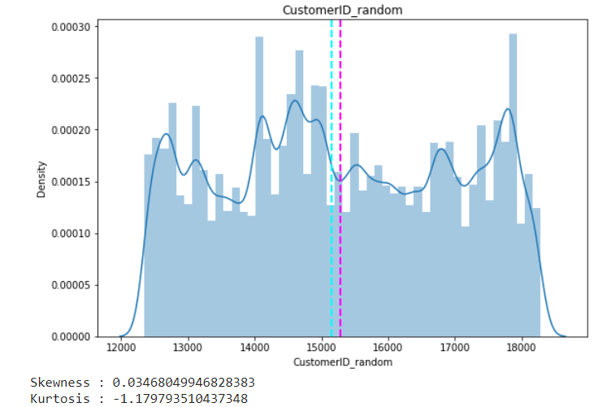
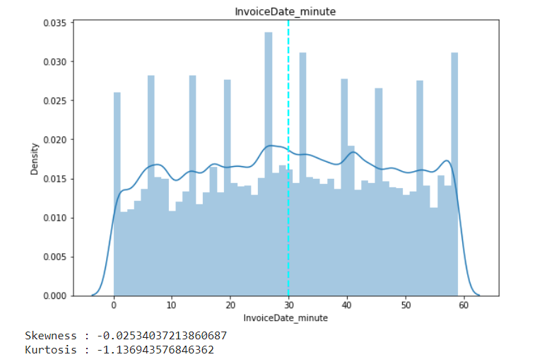
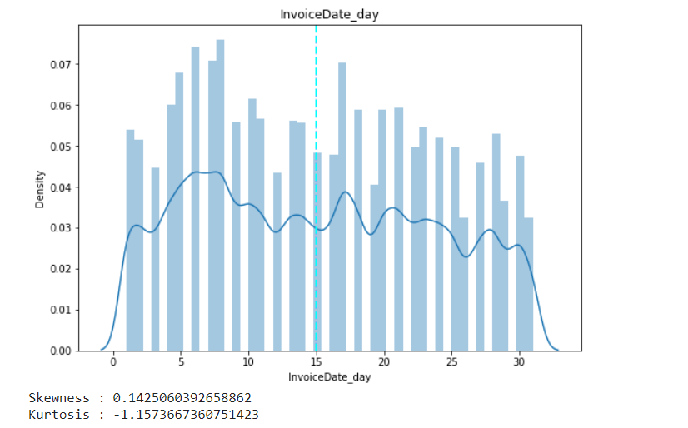
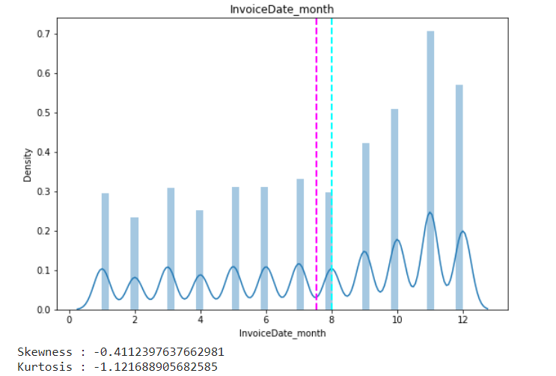
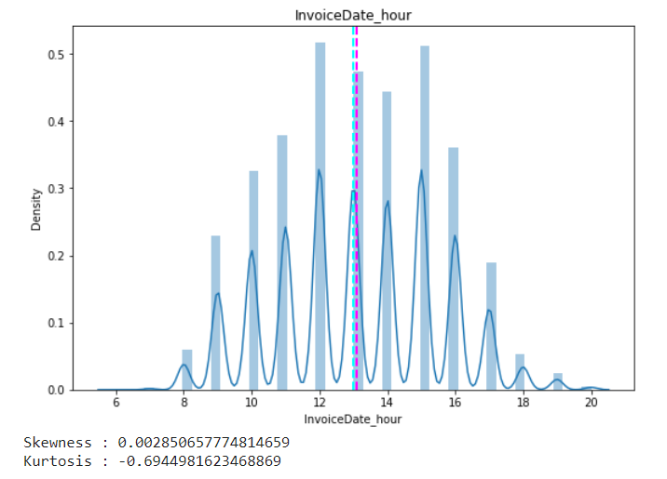
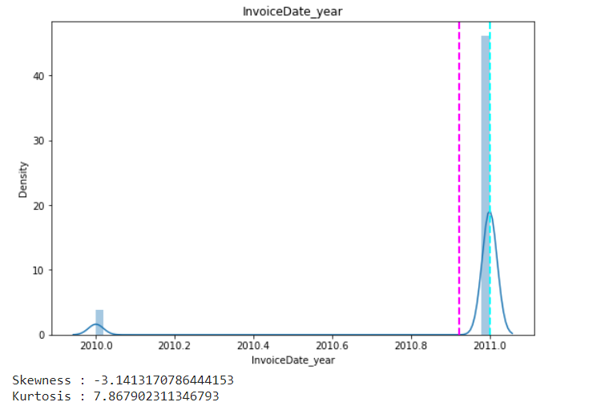
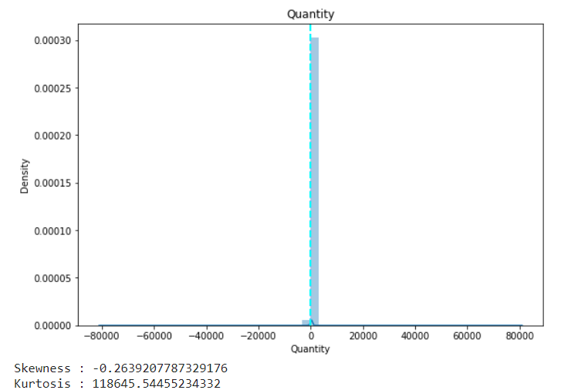
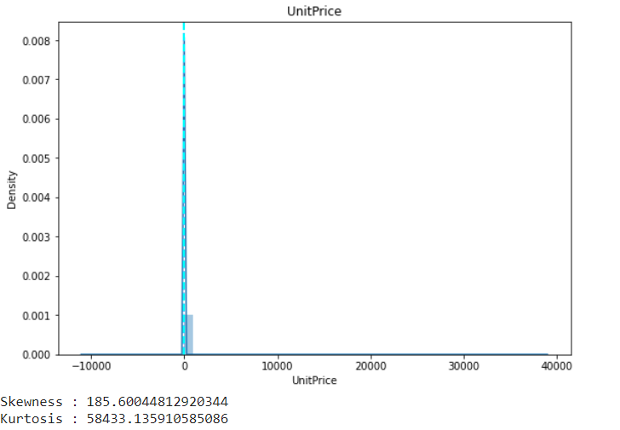
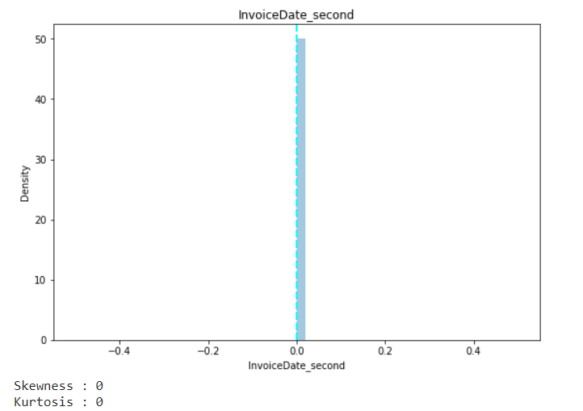
Mean Distribution of Features

Slide 8
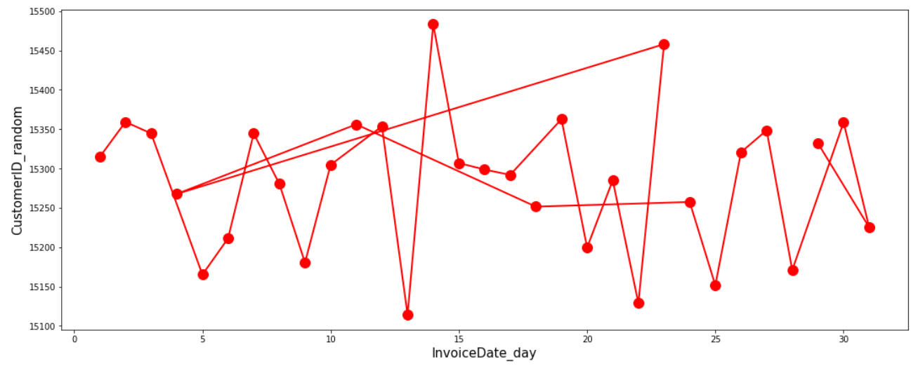
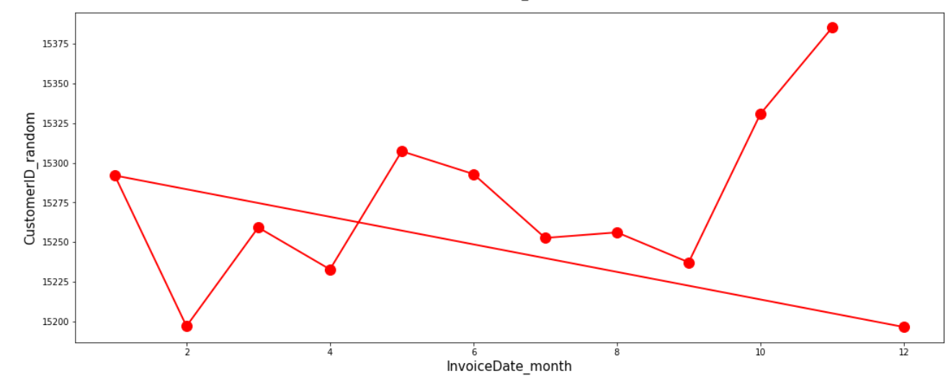
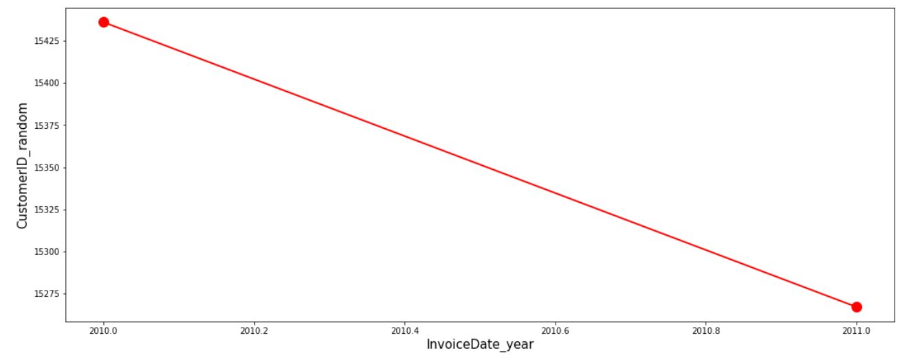
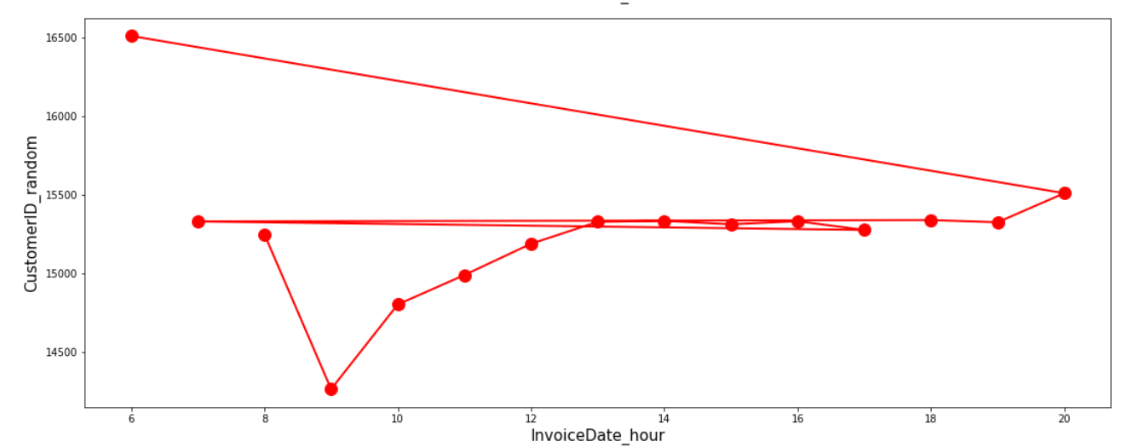
Spread over time

Slide 9
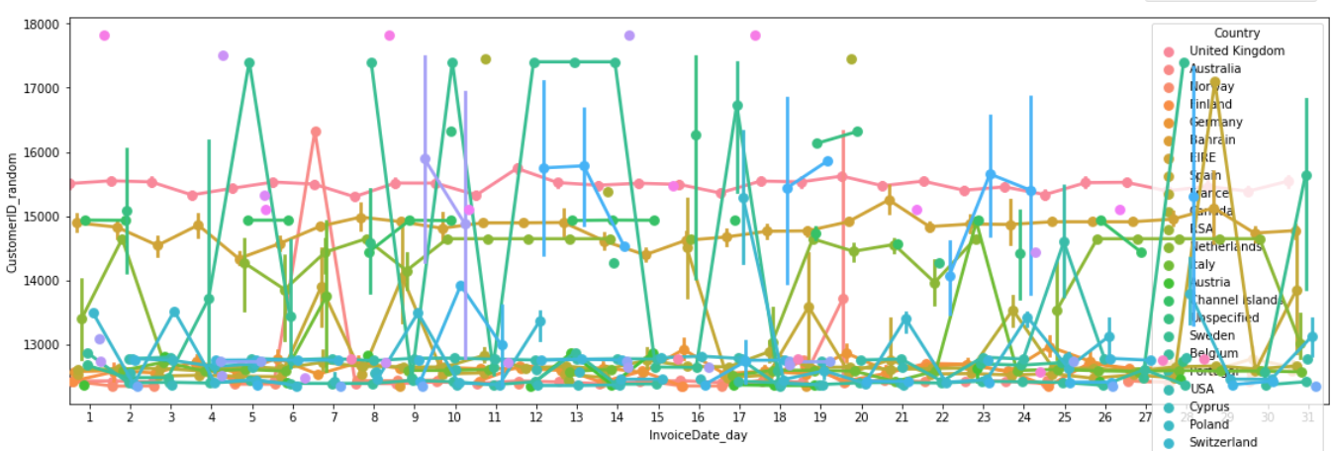
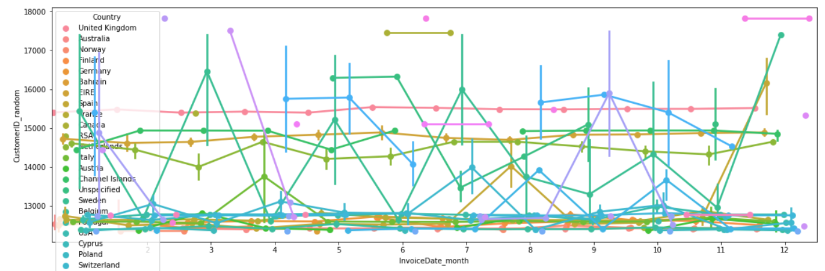
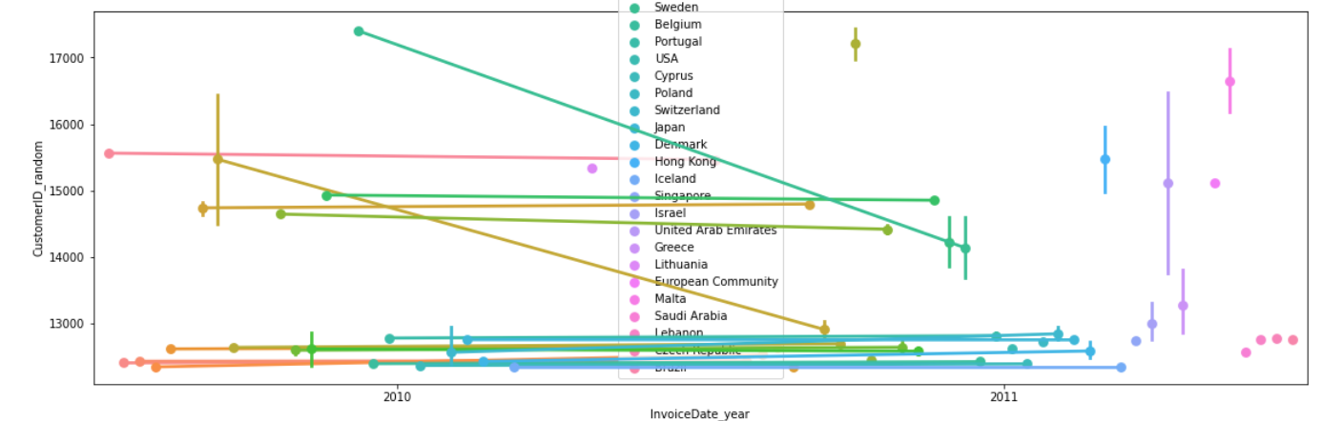
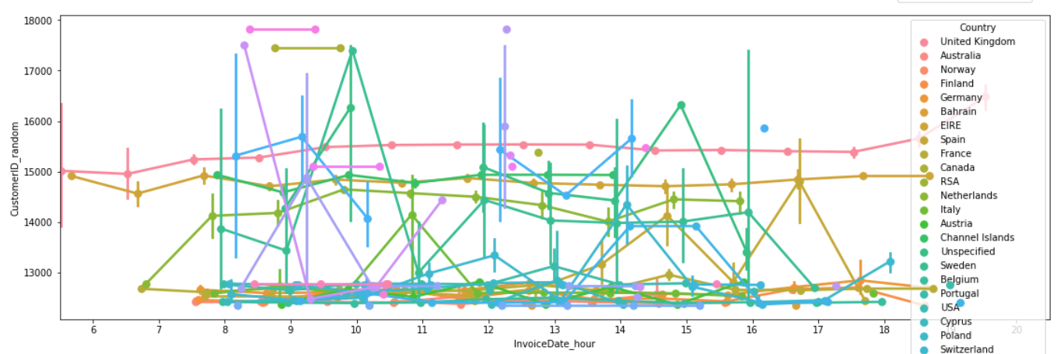
Spread over time and Country

Slide 10
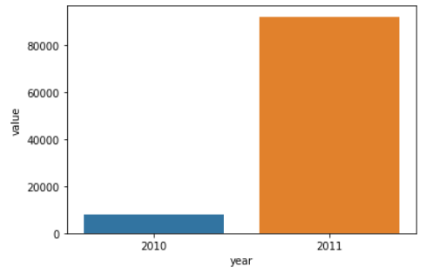
Distribution of Number of reviews

Slide 11
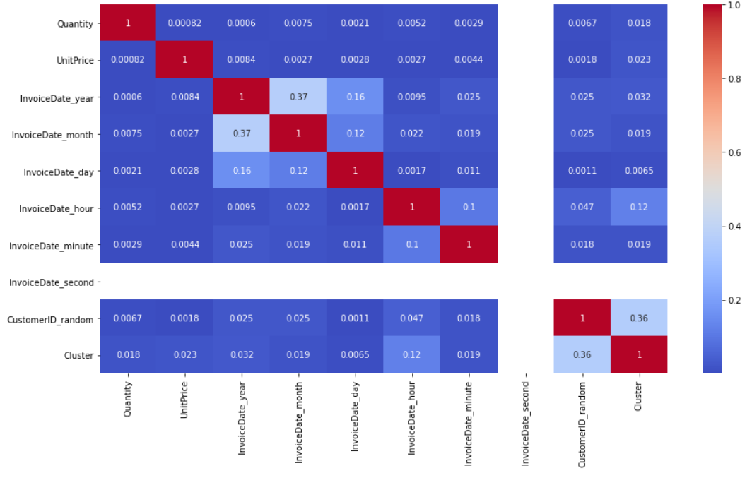
Correlation Matrix

Slide 12
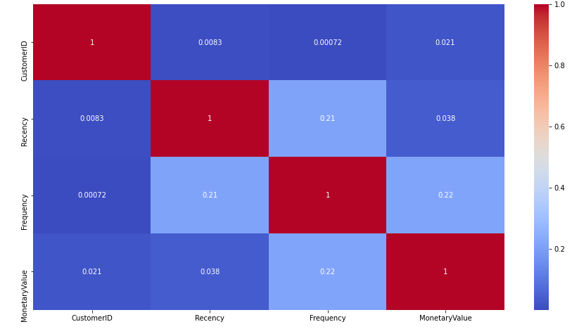
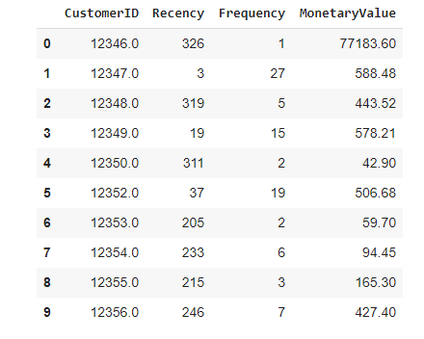
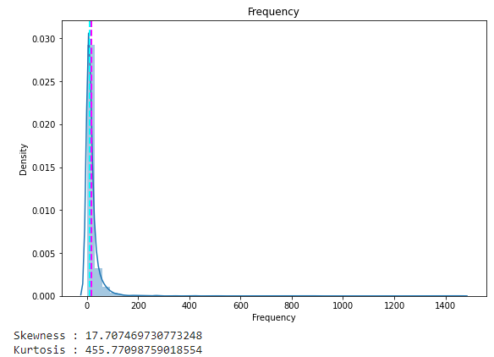
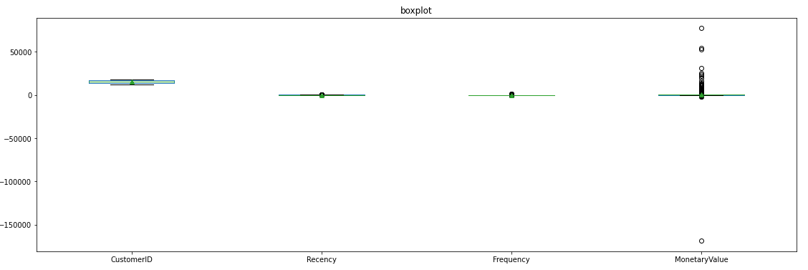
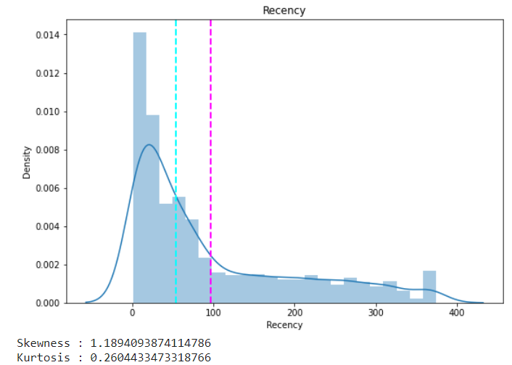
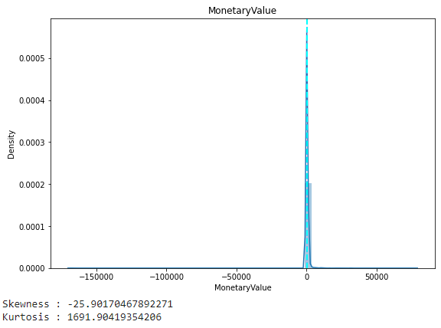
RFM Table for Customer ID
R (Recency): Number of days since last purchase
F (Frequency): Number of tracsactions
M (Monetary): Total amount of transactions (revenue contributed)

Slide 13
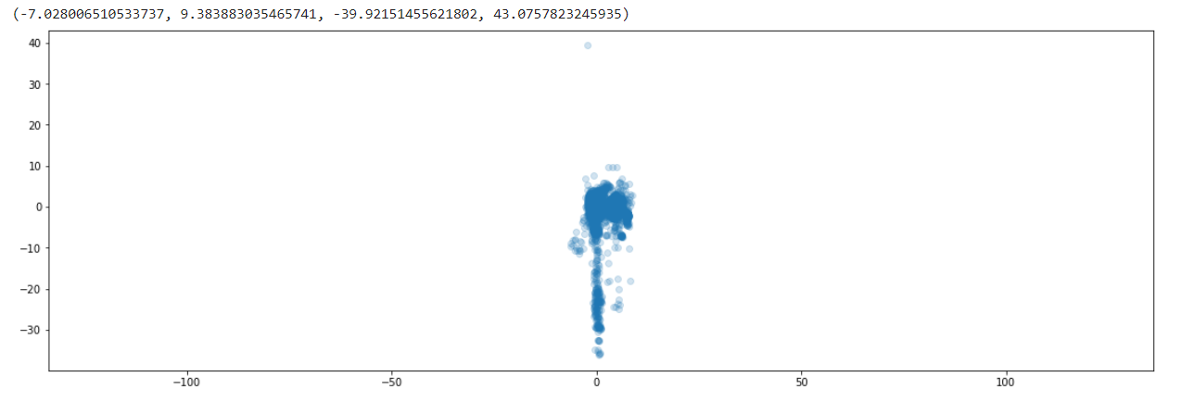
Data Preparation
● One Hot Encoding
● Outlier Treatment
● Standard Scaler Scaling
● Principal Component Analysis (n_components = 4)

Slide 14
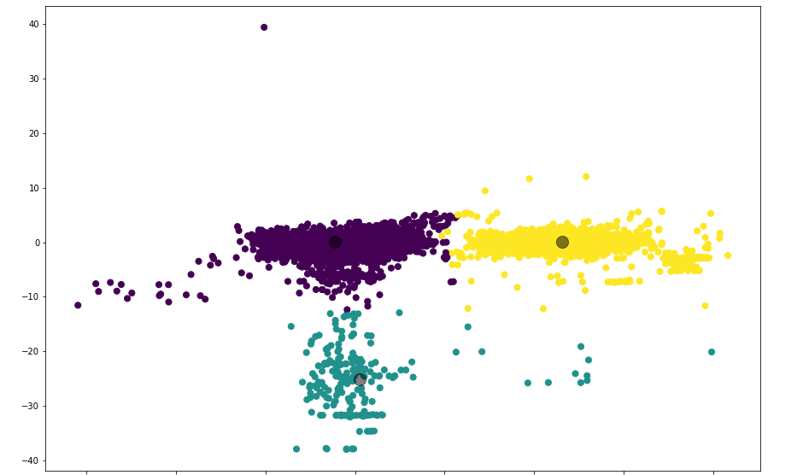
K Means Clustering
Hyper parameters
{n_clusters=3, max_iter=1000, random_state=10}

Slide 15
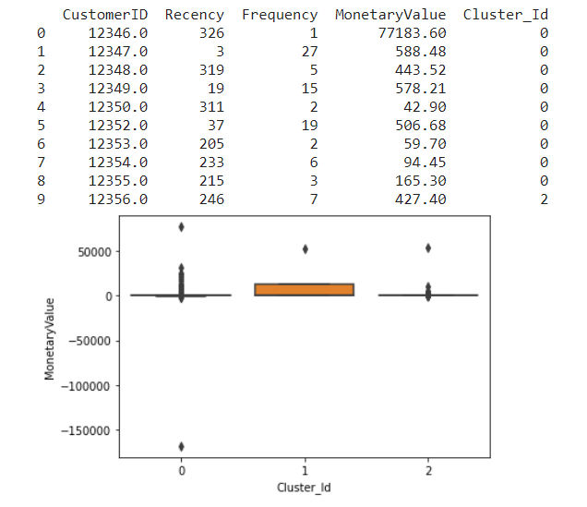
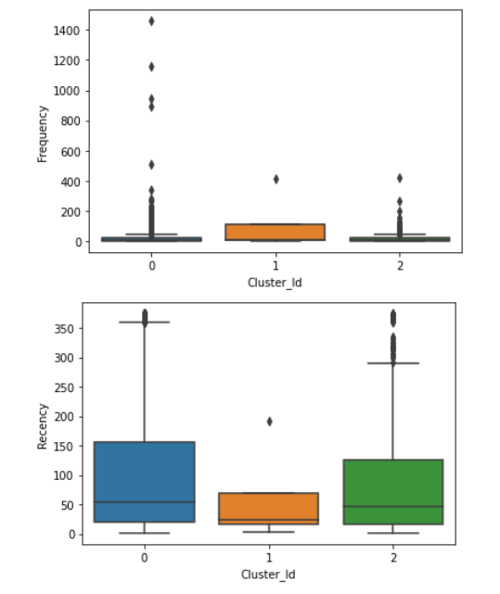
RFM For Cluster

Slide 16
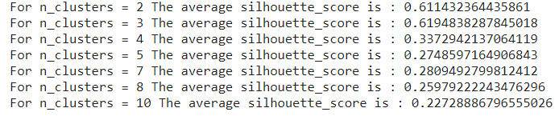
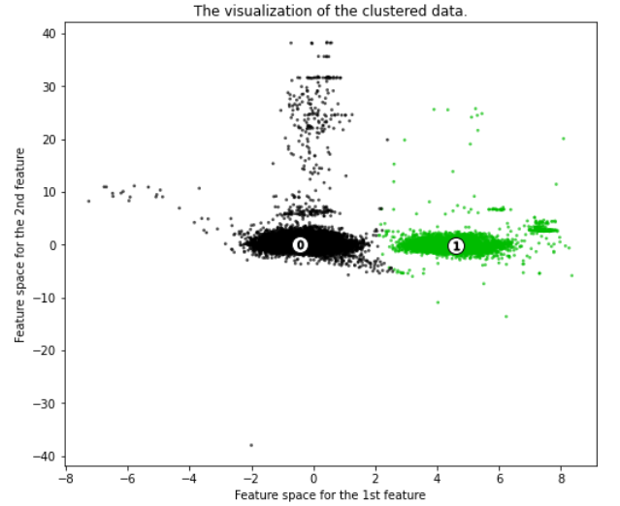
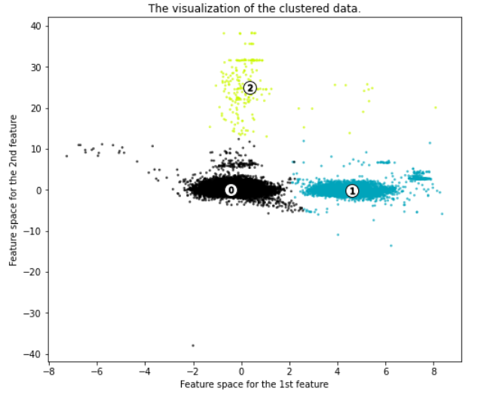
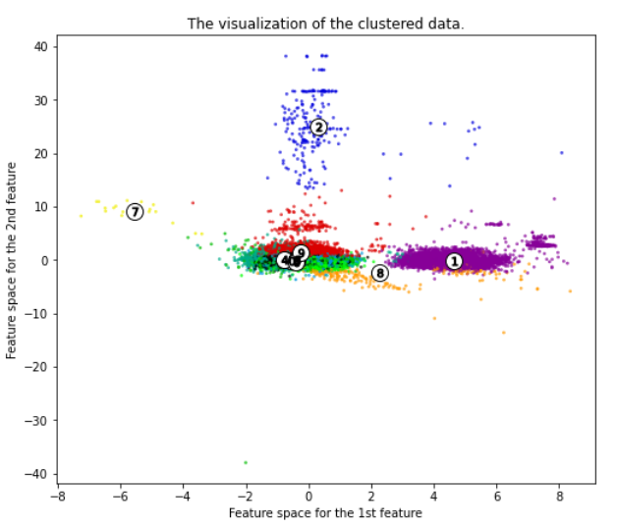
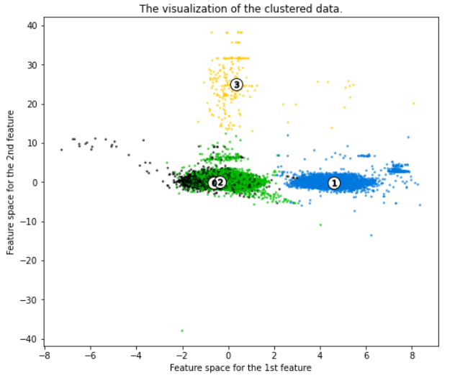
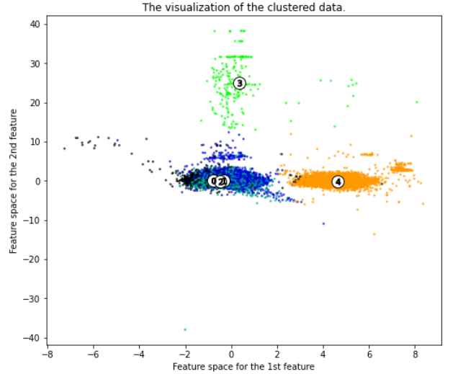
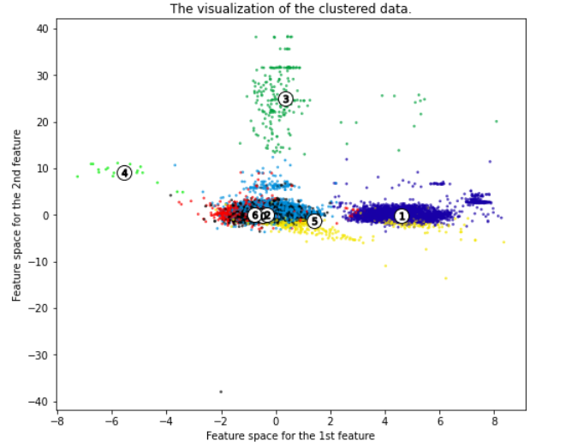
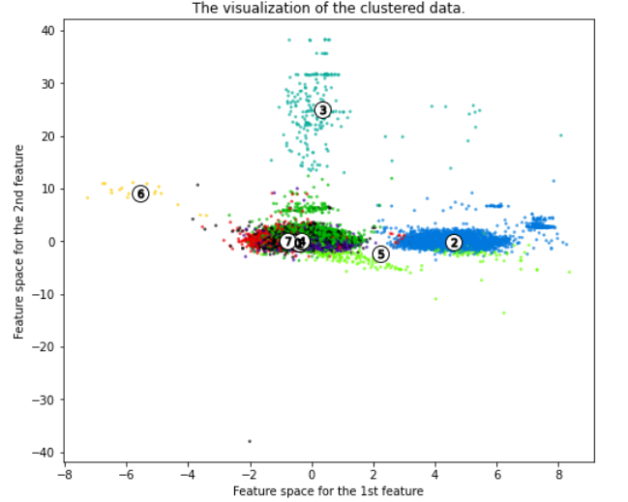
K-Means Clustering with Silhouette
Hyper parameter
{ n_clusters=[2,3,4,5,7,8,10], max_iter=1000, random_state=10 }

Slide 17
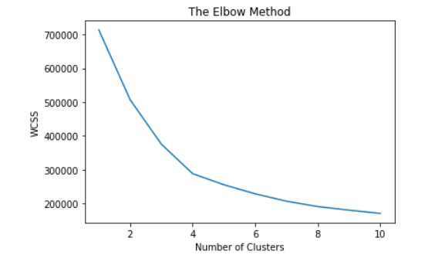
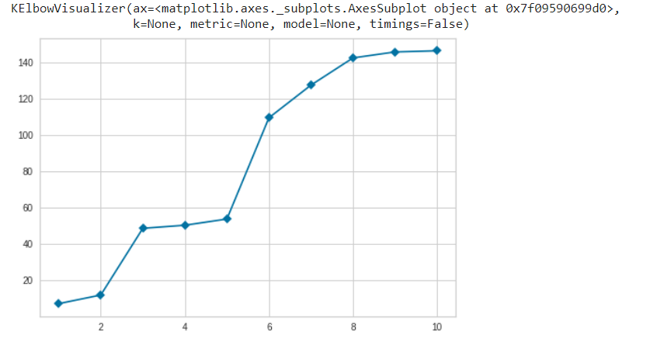
K-Means Clustering with Elbow method
Hyper parameter
{ n_clusters=[1,10],
init='k-means++',
random_state=0}

Slide 18
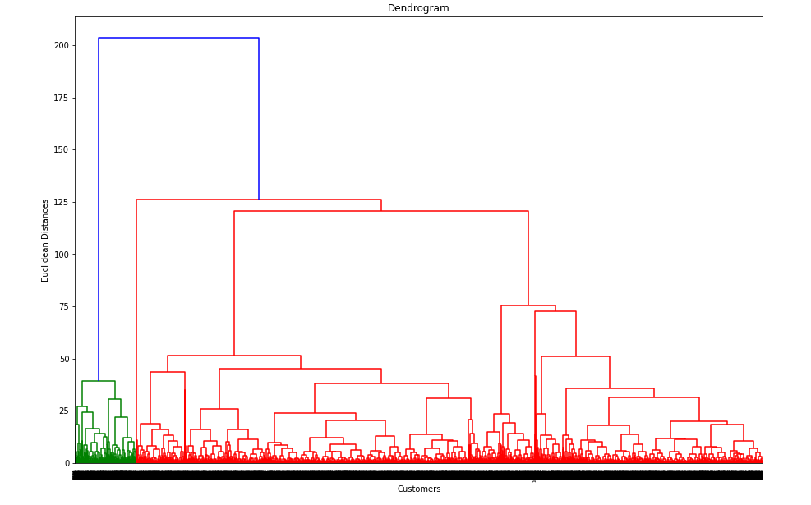
Hierarchical Clustering
Hyper parameter
AgglomerativeClustering
{ n_clusters = 3,
affinity = 'euclidean',
linkage = 'ward‘}

Slide 19

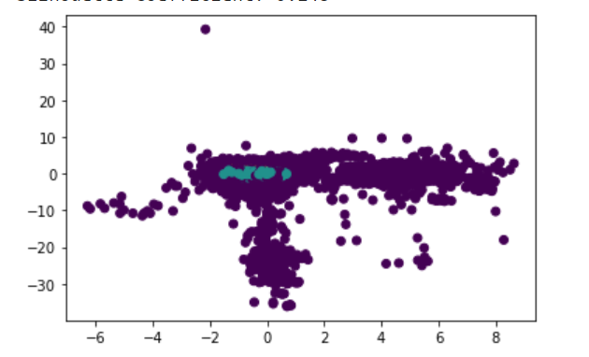
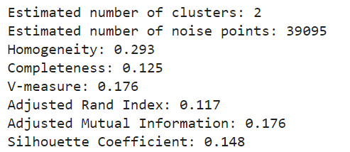
Density-Based Spatial Clustering Of Applications With Noise (DBSCAN)
Hyper parameter
{ eps=0.3,
min_samples=100 }

Slide 20
Challenges
Large Dataset to handle.
Needs to plot lot of Graphs to analyse.
Lot of NaN values.
Continuous Runtime and RAM Crash due to large dataset.
Carefully tuned Hyper parameters .

Slide 21
Conclusion
K-Means Clustering with Silhouette gives the highest score of 61.9% for number of clusters 3.
Sales has been increased from 2010 to 2011.
RFM for Cluster ID box plots tells well about Cluster detail.
We can deploy this model.

Slide 22
THANK YOU Q & A

